Slide 1
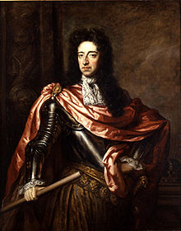
Chapter 17: British Statebuilding in the 17th and 18th Centuries
By Brady Glasser
William III by Sir Godfrey Kneller

Slide 2
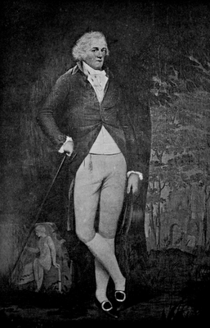
What is the Gentry?
The gentry was a group of middle-class landowners in England. The gentry represented about 2% of the population and dominated British politics during the 17th century. The gentry was a force independent of the nobility and the monarch, through their control of Parliament and their House of Commons.
The gentry have been thought of as a “lesser nobility”. They enjoyed a collective identity, interests, power over the people, heightened social status and collaborative administration as per the House of Commons.
Edward Austen Knight, a member of the gentry

Slide 3
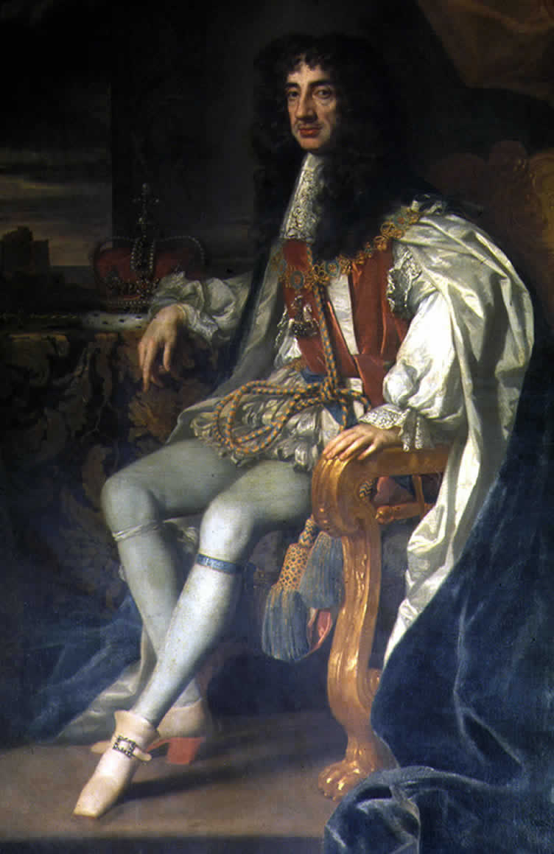
Monarchial Decline
The son of the executed Charles I, Charles II, became the model for a nonabsolutist regime.
Reign: 1660-1685
Still summoned and dissolved Parliament, appointed all bureaucratic positions, and signed every law
Star Chamber dissolved, could not arrest a member of Parliament, could not create seats in the Commons.
Fixed income, could not gather funds without Parliamentary consent; estate financed by beer tax
Portrait of Charles II of England in the robes of the Order of the Garter, Peter Lely

Slide 4
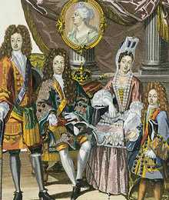
The Succession
Gentry feared successor to the throne, James II, would restore Catholicism in England
James challenged the gentry by making Catholic appointments to the bureaucracy
Gentry encouraged Protestant rulers of the United Provinces, William III and his wife, Mary, to take over the English throne
Event known as Glorious Revolution, completely bloodless as James II decided to flee to France
The Glorious Revolution confirmed the power of Parliament in the coming centuries

Slide 5
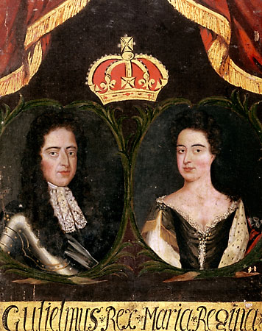
William and Mary
The Dutch rulers William III and Mary ascended to the throne as a joint monarchy, with the intent of bringing England into his fight with Louis XIV
Bill of Rights- act of legislation determining succession to the throne, Parliamentary powers, civil rights
Act of Toleration- end of religious persecution (only members of Church of England could take offices or vote)
1694 statute declared Parliament had to meet once every three years
William guided England into a viscous foreign policy, used bureaucratic positions to his aims
© The British Library/Heritage-Images

Slide 6
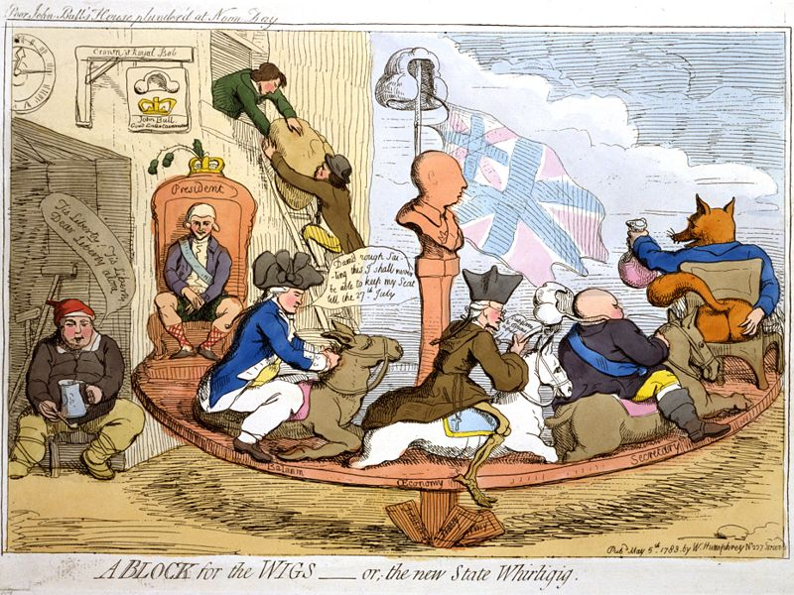
Whigs and Tories
Two parties: Whig and Tory
Whig- opposed royal legislation, party for the empowerment of Parliament
Tory- pro-monarchy, favored traditional Anglicanism
Whigs mostly in power, with Tory party briefly winning elections due to weariness of war with France
With the ascension of George I to the throne, the Whigs secured their position in power for a century.
“A Block for the Wigs—or, the new State Whirligig” by W. Humphrey

Slide 7
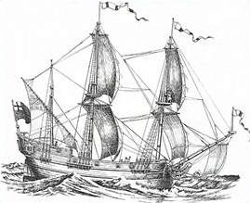
Naval Power and Finance
English navy was strongest in the sea, prevailed in power struggle with France
Union of Scotland and England made worldwide influence even more possible
Bank of England (est. 1694) paved way for England to become financial superpower, displayed commitment of the upper class to English structure
Newly founded colonies gave good maritime trade to London, bolstered entire economy
Slave ship Henrietta Marie, 1700

Slide 8
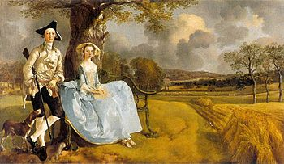
Society in England
English had highest quality of life in Europe
Little starvation, though systems of relief for the poor were sometimes inhumane, but provided the people with necessities
London approached 500,000 citizens; many areas were crime-infested slums
Opportunities for advancement were increasing, and jobs in many different areas were available (overseas trading, bureaucracy, luxury goods)
Mr and Mrs Andrews (1748-49), by Thomas Gainsborough
Notes:
\

Slide 9
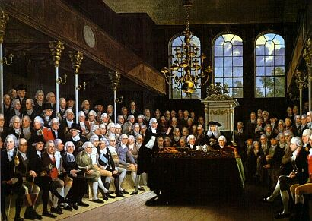
Growth of Stability
The advent of common people becoming interested in politics paved way for the worldwide dominance the British began to exert
Landowners controlled the nation; dominated the House of Commons
Many voting districts controlled by a single wealthy family, who secured the votes of the citizens in the area
Alliances were dependent upon strong factions within the Whigs and Tories; politics revolved around these subgroups
A Karl Anton Hickel painting of the House of Commons, 1793

Slide 10
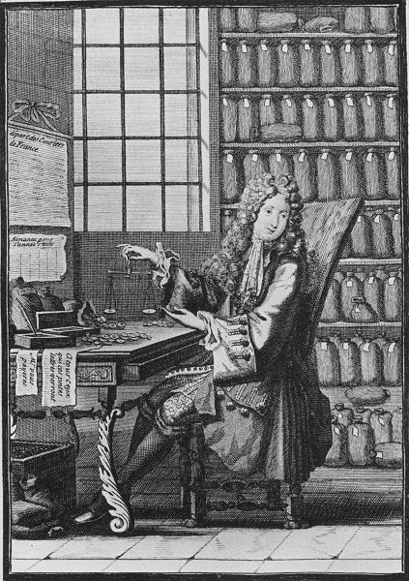
War and Taxes
In the past, Britain had never needed a standing army
Threat of French invasion gave Britain cause to develop an expanded navy and military force of over 200,000 men
Bureaucracy tripled in size due to this
Upper classes in Britain paid taxes and mainted healthy and accepting relationships with gentry and commercial classes
Very poor stayed very poor mostly; crime flourished throughout England, even with capital punishment
French, Merchant Banker at Work, 1700

Slide 11
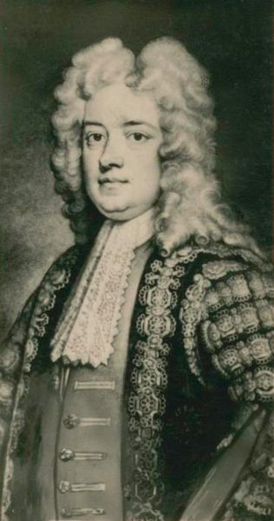
Walpole and Parliament
George I of Hanover did not speak any English, giving Parliament even more power
Sir Robert Walpole was the most important figure in Parliament, due to his skill with fiscal policy and trade
Walpole governed by strictly Whig policies, characterized by his strong want for peace with other nations
Admired for his sense of prudence and vigilance
Portrait of Robert Walpole (1676-1745), Artist Unknown

Slide 12
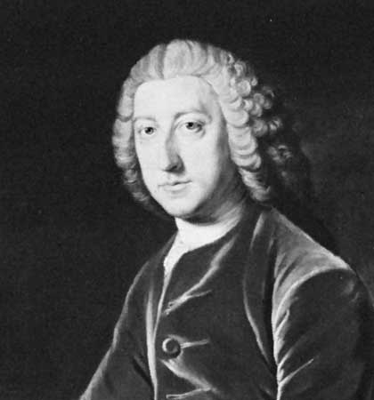
Commercial Interests
Expansion increased social, political, and economic weight of the middle class
Walpole’s policies pleased landlords but disturbed merchants afraid of French economic practices
Parliamentary politician William Pitt advocated France’s removal from the sphere of maritime trade- champion of merchants
Envisioned economic and imperial dominance for Britain over the world
William Pitt by W. Hoare, from 1754

Slide 13
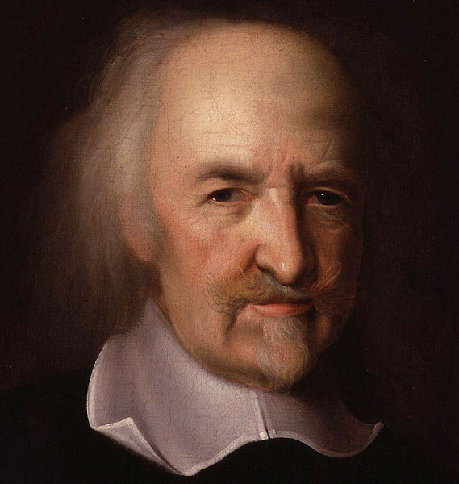
Hobbes and Locke
Thomas Hobbes- political theorist with major work of Leviathan (1651). Envisioned humanity as naturally evil, selfish, in a state of war; everyone should submit to sovereign for the sake of order, abandoning liberty
State of nature- natural human mindset, preceding the existence of any society
John Locke- theorized the tabula rasa, or clean slate; humanity’s natural state is one of complete blankness, and we learn through our experiences
On Civil Government- major work of John Locke, argues that every individual has right to life, liberty and property ownership; there must be a sovereign power, but the sovereign does not have right over the people if it plans to betray their natural individual rights
John Michael Wright, Thomas Hobbes

Slide 14
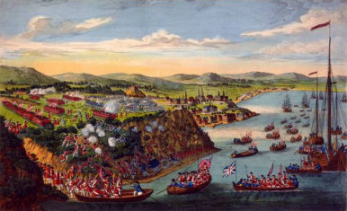
The Seven Years’ War
Mostly involved Continental Europe; sphere of battle for Britain was against France in North America
Much of the war took place in Canada; Britain had many victories here, and came out victorious, with France ceding its “New French” land to Britain
Called the French and Indian War
Treaty of Paris signed, asserting Britain’s victories
"A view of the taking of Quebec" by Hervey Smyth

Slide 15
Works Cited
Chambers, Mortimer. The Western Experience. Boston: McGraw-Hill, 2003. Print.
Coss, Peter R. The Origins of the English Gentry. Cambridge: Cambridge UP, 2003. Print.
Stephen Taylor, ‘Walpole, Robert, first earl of Orford (1676–1745)’, Oxford Dictionary of National Biography, Oxford University Press, 2004. Web.
This image of William III and his British family illustrates the continuity which co-existed with the 'Glorious Revolution's' irregularity. Digital image. Open.edu. N.p., 7 Jan. 2001. Web. 18 Dec. 2012.

